Slide 1
Introducing Evaluations
Sara Muneeb
sara.muneeb@cuilahore.edu.pk
Computer Science Department

Slide 2

Introduction
Evaluation is integral to the design process.
It involves collecting and analyzing data about users’ or potential users’ experiences when interacting with a design artifact
such as a screen sketch, prototype, app, computer system, or component of a computer system.

Slide 3
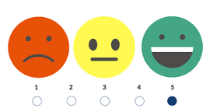
Evaluation
Evaluation focuses on both
the usability of the system (that is, how easy it is to learn and to use)
the users’ experiences when interacting with it (for example, how satisfying, enjoyable, or motivating the interaction is).

Slide 4
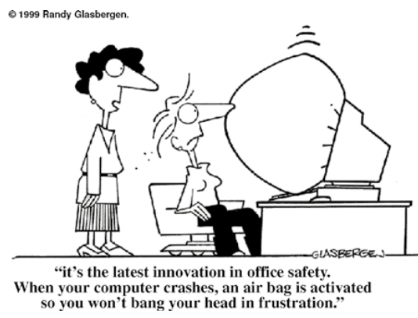
Why Evaluate?
User experience involves all aspects of the user’s interaction with the product.
Nowadays users expect much more than just a usable systems.
Pleasing and engaging experience
Simplicity and elegance
Joy of own and use
Well designed

Slide 5
What to Evaluate?
What to evaluate ranges from low-tech prototypes to complete systems, from a particular screen function to the whole workflow, and from aesthetic design to safety features.
Different types of evaluations will be needed depending on the type of product, the prototype or design concept, and the value of the evaluation to the designers, developers, and users.
In the end, the main criteria are whether the design does what the users need and want it to do; that is, will they use it

Slide 6
Where to Evaluate?
Where evaluation takes place depends on what is being evaluated.
Some characteristics, such as web accessibility, are generally evaluated in a lab because it provides the control necessary to investigate systematically whether all of the requirements are met.
Some interfaces can be evaluated more effectively in natural settings, which are often referred to as in-the-wild studies.

Slide 7
When to Evaluate?
The stage in the product lifecycle when evaluation takes place depends on the type of product and the development process being followed.
For example, the product being developed could be a new concept, or it could be an upgrade to an existing product.
There are two levels of evaluations
Formative evaluations
Summative evaluations

Slide 8
Formative Evaluations
When evaluations are conducted during design to check that a product continues to meet users’ needs, they are known as formative evaluations.
Formative evaluations cover a broad range of design processes, from the development of early sketches and prototypes through to tweaking and perfecting a nearly finished design.

Slide 9
Summative Evaluations
Evaluations that are carried out to assess the success of a finished product are known summative evaluations.
If the product is being upgraded, then the evaluation may not focus on discovering new requirements but may instead evaluate the existing product to ascertain what needs improving

Slide 10
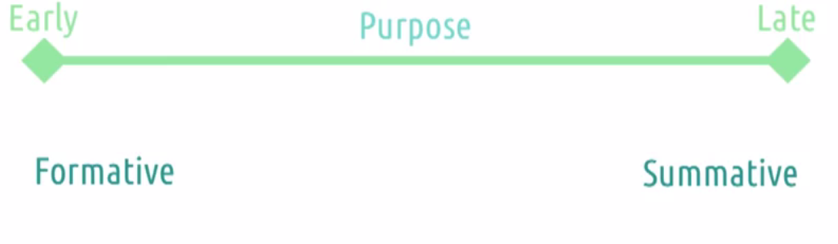
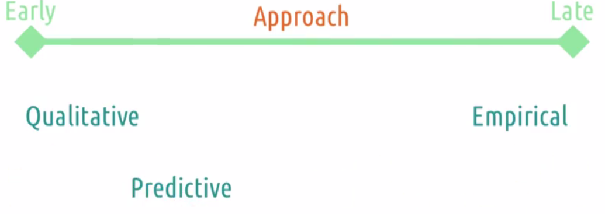
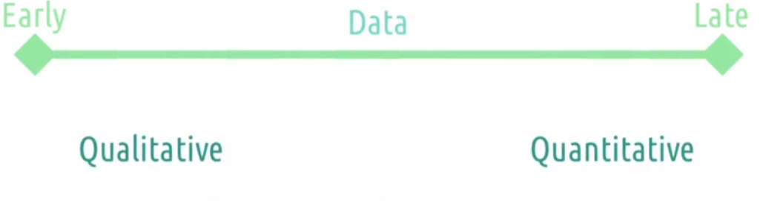
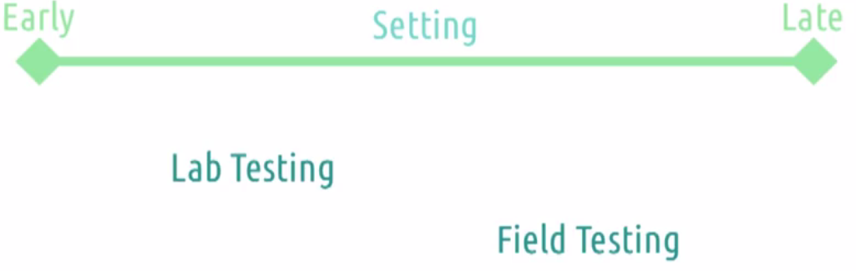
Evaluation Timeline

Slide 11
Types of Evaluation - Controlled
Controlled settings directly involving users (examples are usability labs and research labs)
Users’ activities are controlled to test hypotheses and measure or observe certain behaviors.
The main methods are usability testing and experiments.

Slide 12
Usability Testing
This approach to evaluating user interfaces involves collecting data using a combination of methods in a controlled setting
Often, usability testing is conducted in labs
The primary goal is to determine whether an interface is usable by the intended user population to carry out the tasks for which it was designed.
Data Collection [qualitative and quantitative]
video recording, software logging. Observations, questionnaire , interviews

Slide 13
Experiments
Experiments are typically conducted in research labs at universities or commercial labs to test such hypotheses.
These include providing the same instructions to all of the participants
The data collected would then be analyzed to determine whether the scores for each condition were significantly different?

Slide 14
Types of Evaluation – Natural
Natural settings involving users (examples are online communities and products that are used in public places)
There is little or no control of users’ activities to determine how the product would be used in the real world.
The main method used is field studies (for example in-the-wild studies).

Slide 15
Field Studies
The goal of field studies is to evaluate products with users in their natural settings. Field studies are used primarily to
Help identify opportunities for new technology
Establish the requirements for a new design
Facilitate the introduction of technology or inform deployment of existing technology in new contexts
Methods that are typically used are observation, interviews, and interaction logging.

Slide 16
Types of Evaluation - Indirect
Any settings not directly involving users
Consultants and researchers critique, predict, and model aspects of the interface to identify the most obvious usability problems.
The range of methods includes inspections, heuristics, walk-throughs, models, and analytics

Slide 17
Cognitive Walkthrough
Cognitive walk-throughs involve simulating a user’s problem-solving process at each step in the human-computer dialogue and checking to see how users progress from step to step in these interactions.
It involves answering a set of prescribed questions, with the goal of identifying those aspects of the interface that could be challenging to new users.

Slide 18
Heuristic Evaluation
Heuristic evaluation is a process where experts use rules of thumb to measure the usability of user interfaces in independent walkthroughs and report issues.
Evaluators use established heuristics and reveal insights that can help design teams enhance product usability from early in development.

Slide 19

Analytics
Analytics is a technique for logging and analyzing data either at a customer’s site or remotely.
Web analytics is the measurement, collection, analysis, and reporting of Internet data to understand and optimize web usage.

Slide 20
Selecting and Combining Methods
The benefits of controlled settings include being able to test hypotheses about specific features of the interface where the results can be generalized to the wider population.
A benefit of uncontrolled settings is that unexpected data can be obtained that provides quite different insights into people’s perceptions and their experiences of using, interacting, or communicating through the new technologies in the context of their everyday and working lives

Slide 21
Issue to Consider When Doing Evaluations
Two central issues are
Informing participants about their rights.
Making sure you take into account biases and other influences that impact how you describe your evaluation findings.

Slide 22
Informing Participants About Their Rights
Ensure that participants are not endangered physically or emotionally
Their right to privacy is protected
particularly the details about how participants’ data is collected and will be treated.
Participants must be told
what they will be asked to do
the conditions under which data will be collected
what will happen to their data when they finish the task.
Participants must also be told that they may withdraw from the study at any time if they want.

Slide 23
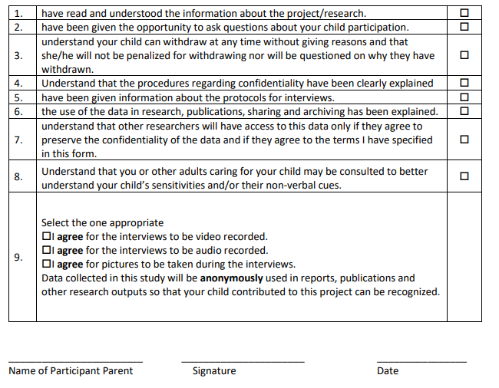
Getting Their Consent
All the related information is usually presented to participants on a form, often referred to as a consent form, that each participant reads and signs before the study starts.

Slide 24
Issues - Choice of Method and How the Data Is Interpreted
Reliability
how well it produces the same results on separate occasions under the same circumstance
Validity
whether the evaluation method measures what it is intended to measure.
Ecological Validity
concerns how the environment in which an evaluation is conducted influences or even distorts the results.
Bias
occurs when the results are distorted.
Scope
refers to how much its findings can be generalized

Slide 25

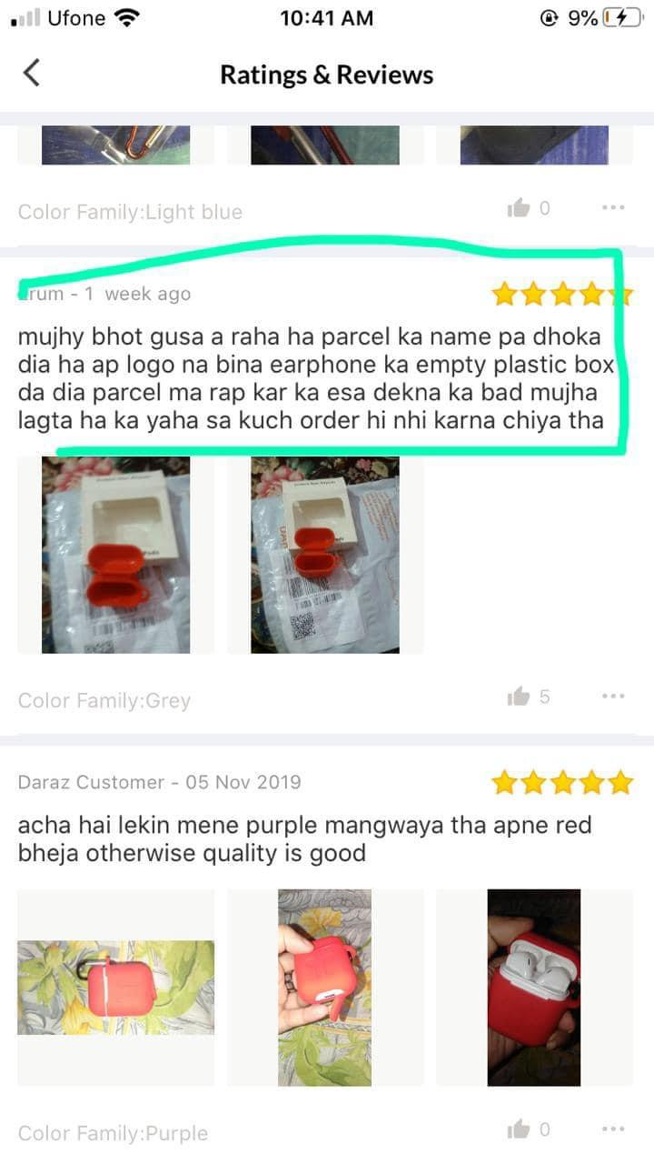
Conclusion
Why, what, where and when of evaluation
Types of evaluations
Issues to consider when doing evaluations

